Slide 1
5. Stacks and Queues
5.1. Basic Stack Operations
5.2. Basic Queue Operations
5.3. Implementation of Stacks and queues

Slide 2
The Stack

Slide 3
Stack
Linked list and arrays allow one to insert and delete elements at any place in the list
At the beginning
At the end or
In the middle
There are frequent situations where one wants to restrict insertions and deletions so they can take place only at the beginning or the end of the list, not in the middle
Two of the data structures that are useful in such situations are
stacks and
queues

Slide 4
Stack
A stack is a linear data structure (a list of elements) that has restricted data access
Items (or elements) may be added (or inserted) and removed only at one end
Is an ordered collection of entries that can only be accessed at one end
Is a data structure of ordered entries such that entries can only be inserted and removed at one end (called TOP)
When we say a stack is ordered we mean that there is one that can be accessed first (the one on the top), that can be accessed second (just below the top), the third one and so forth

Slide 5
Stack
It is a data structure that has access to its data only at the end (LL) or TOP (array)
It operates on Last-In First-Out (LIFO) basis
The last item to be added to a stack is the first item to be removed
This means, elements are removed from the stack in the reverse order of that in which they were inserted into the stack

Slide 6
Stack
Every day examples of such structures
Stack of dishes
Stack of pennies
Stack of folded towels
Stack of books
An item may be added or removed from the top of any of the above stacks

Slide 7
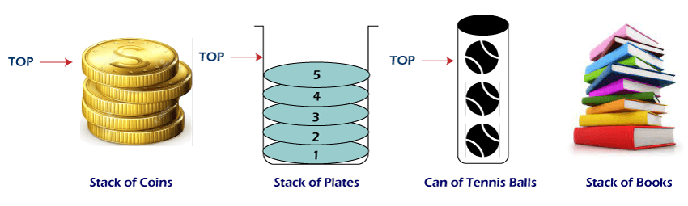

Slide 8
Stack
Other names used for stacks
Piles
Push down lists
A stack has many applications in computer science
To be addressed later

Slide 9
Stack
A stack has two basic operations, push and pop
push (or put)
Is a term used for inserting or adding data (or element) at the top of the stack or into the stack
Could be written as Is a function to add an entry at the top of the stack
Needs at least one parameter

Slide 10
Stack
pop (get)
Is a term used to delete or remove an element or data from the top of the stack
Could be written as a function to remove the top entry
No need to define the element to be removed in case of pop because there is only one element to be removed, the element at the top
No need to use parameter for pop operation
By default pop operation takes (or removes) the top element
Is the synonym for delete when it comes to stack

Slide 11
Stack
There are no functions that allow a program to access entries other than the top entry
To access any entry other than the top one, the program must remove entries one at a time form the top until the desired entry is reached
Include examples of stacks
Include example 1, 2, and 3

Slide 12
Implementation of stacks
Stacks can be implemented both as
An array (contiguous list) and
Linked lists
There are a set of operations that will work with either type of implementation (push, pop, peek, isEmpty, isFull, sizeOfStack)

Slide 13
Array representation of Stacks
The array acts as a stack
Let the array be called STACK
Let MAXSTK
be the maximum number of elements that can be held by the stack
Capacity of the stack
Array implementation requires this constant because it uses a fixed size array to hold the items of the stack
The linked list implementation will use dynamic memory instead and such a constant is not required

Slide 14
Array representation of Stacks
Suppose the stack has the following data structure (or definition)
int STACK[MAXSTK];
We should have a an integer variable ( or pointer variable) that points to the top element in the stack
Call this variable TOP
This implies TOP will contain the index of the top element of the stack

Slide 15
Array representation of Stacks
At the beginning the TOP variable (or pointer) must be initialized with -1
That is, we have no element in the stack at the beginning
int TOP = -1;
TOP also tells us the total number of elements in the STACK
How do you calculate the total number of elements in the stack using TOP?
Total number of elements in the stack = TOP + 1;
That is, TOP + 1 is the total number of elements in the stack

Slide 16
Stack Errors
Stack overflow
This is the condition resulting from trying to push (or add) an item to a full stack
To avoid stack overflow, compare the capacity constant MAXSTK to the stack’s current size obtained with the size function

Slide 17
Stack Errors
Stack Underflow
The condition resulting from trying to POP (remove) an item from an empty stack
If a program attempts to POP an item of empty stack, then it is called stack underflow
In order to avoid a stack underflow, it is possible to write a function that tests whether the stack is empty or not

Slide 18
To push or store an element into the stack
do the following
Check if there is enough space
In order to store data
TOP must be <= MAXSTK – 2 or
TOP must be < MAXSTK – 1
because to store on the top, the top must be empty
If yes increment TOP and then store the element in STACK[TOP]
(incrementing must be done before storing/pushing the element)
If no, No space in the stack and send an overflow message (stack overflow)
We use the operation push

Slide 19
push Operation
Is a function to push or store an element into the stack
There is nothing (i.e., data) to be returned by this function because it does only push element
Thus, it must be of type void

Slide 20
push Operation
Algorithm
Step 1 - increment the stack TOP by 1
Check whether stack is always less than upper limit of the stack
If it is less than the upper limit go to step 2 else report “Stack Overflow”
Step 2 - put the new element at the position pointed by TOP

Slide 21
push Operation
/* This procedure pushes an ITEM on to a stack*/
void push(STACK, TOP, MAXSTK, ITEM)
{
// Is stack already filled?
If(TOP==MAXSTK-1)
cout<<“\nOVERFLOW” //print overflow and return
else
{
TOP=TOP + 1; // TOP is set to increase by 1. The value of TOP, in case //of push, is changed before the insertion in push
STACK[TOP]=ITEM //insert ITEM in a new TOP position
}
return;
}

Slide 22
push Operation
Remark
Frequently, TOP and MAXSTK are global variables and hence procedure push can be called using only push(STACK, ITEM)
If the array STACK is also declared globally, the procedure push can be called using only push(ITEM)

Slide 23
Push Operation
C++ implementation
Include F
See stack2.cpp
See stackz.cpp

Slide 24
To POP or remove an element from the stack
do the following
Check if there is data in the stack (how?)
Check if TOP > = 0
If yes
There is at least one element
Copy/remove the element in STACK[TOP]
Then decrement the value of the TOP
If NO
No element in the stack
Send stack underflow message
We use the operation pop()

Slide 25
pop Operation
The function pop has to return a data, top element, because the element may be used somewhere else
The data type of the pop function is the same as the type of the STACK itself, in this case the type of the array

Slide 26
pop Operation
Algorithm for pop() function
Step 1
if the stack is empty
give the alert “Stack Underflow!” and quit
else
go to step 2
Step 2
Hold the value for the element pointed by the TOP
Put a NULL value instead
Decrement the TOP by 1

Slide 27
pop Operation
/* This procedure deletes the top element of the stack and assigns it to the variable ITEM*/
DataType pop(STACK, TOP, ITEM)
{
// Stack has item to be removed?
If(TOP==-1)
cout<<“\nUNDERFLOW” ; //print UNDERFLOW and return (TOP);
else
{
ITEM=STACK[TOP]; // Assign (set) top element to ITEM
STACK[TOP]=NULL;
TOP=TOP – 1;//TOP is decreased by 1. The value of TOP, in case //of pop, is changed after the deletion in pop
}
return (ITEM);
}

Slide 28
pop Operation
Remark
Frequently, TOP and MAXSTK are global variables and hence procedure pop can be called using only pop(STACK, ITEM)
If the array STACK is also declared globally, procedure pop can be called using only pop(ITEM) or simple pop( )

Slide 29
pop Operation
C++ implementation
Include G
Include stack2.cpp (second version)

Slide 30
isEmpty() & isFULL()
We could have other operations, such as an explicit boolean function
isEmpty()- that tests for empty stack
isFull()- that tests for a full stack
togeter with the pop and push functions
Include definitions of isEmpty() and isFull( )
Include D

Slide 31
peek()
Sometimes we need information about the last element without removing the element
For this we use the function peek( ) or also called topData( )
Include the definition for topData( )
Include E

Slide 32
sizeOfStack()
Function to know the current size of the stack
//Returns the number of elements in the stack
int sizeOfStack()
{
/*post condition: return value is total number of items in the stack */
return (TOP + 1);
}

Slide 33
Linked List Implementation of Stack
A linked list is a natural way to implement a stack as a dynamic structure whose size can grow and shrink during execution, without a predefined limit that is determined at compilation
The items in the stack are stored in a linked list, with the TOP of the stack stored at the head node, down to the bottom of the stack at the final node
In case of array implementation, we have a variable TOP to indicate the top element

Slide 34
Linked List Implementation of Stack
In this case, we need two pointers, one pointing to the beginning node (because we need to have a head pointer) of the list and the other the top of the list or node (because operation is performed at the top)
At the beginning, these two pointers must be initialized to NULL
node * headPtr=NULL;
node *topPtr=NULL;

Slide 35
Defining the Structure
struct number {
int num;
number *next;
}
number * bottomPtr =NULL;
number * topPtr=NULL;

Slide 36
To push an element
Check if there is a free space
How is this done?
We need to have a pointer newNumPtr that points to the newly created node
number * newNumPtr=new number;
This is used to reserve new space for our data.
How do we know that this space is reserved?
Is newNumPt != NULL?
If != NULL, it means we have memeory, memory is allocated and this memeory is pointed by newNumPtr and its address is stored in newNumPtr
If the value stored at newNumPtr is NULL we have no space

Slide 37
To push an element
If newNumPtr != NULL is true, then
Store data in the newly created node (How?)
Create a link between the last node and the newly created node.
That is, the next pointer of the last node in the list should point to the newly created node
Make the top pointer to point to the last node
If newNumPtr != NULL is false
Print “Memeory overflow “

Slide 38
Linked list implementation of stacks: push operation
Algorithm
Step 1- if the stack is empty, go to step 2 or else go to step 3
Step 2- create the new element and make bottomPtr and topPtr point to the new element and quit
Step 3- create the new element and make the last (top most) element of the stack to point to it
Step 4- make the new element your top most element by making the topPtr points to it

Slide 39
Linked list implementation of stacks: push operation
Include the C++ code
Include H
See stack5.cpp

Slide 40
Linked list implementation of stacks: push operation
Remarks
The push operation is similar to the insertion operation in a dynamic singly linked list
The only difference here is that you can add the new element only at the end of the list, which means additions can happen only from the TOP
Since dynamic list is used for the stack, the stack is also dynamic, means it has no prior upper limit
So there is no need to check for the overflow condition at all!

Slide 41
To pop an element
Check if there is data in the stack
How do you check whether there is an element in the list or stack?
Is bottomPtr != NULL; (ask this question)

Slide 42
To pop an element
If bottomPtr != NULL is true
bottomPtr is different form NULL
That is, There is data in the list (at least one)
If bottomPtr != NULL is false
bottomPtr=NULL
Stack is empty
There is no element in the stack to pop
Print “Stack Underflow”
Note: 1. topPtr always points to the last node
2. We need a pointer prevNumPtr to point to the previous node of the last node
number * prevNumPtr;

Slide 43
Linked list implementation of stacks: pop operation
Algorithm
If the stack is empty then give an alert message “stack Underflow” and quite; or else proceed
If there is only one element left go to step 3 or else step 4
Free that element and make bottomPtr and topPtr to point to NULL and quit
Make “targetPtr” point to just one element before top;; free the top most element ; make targetPtr to point to the top most element

Slide 44
Linked list implementation of stacks: pop operation
Include the C++ code
Include I
See stack5.cpp

Slide 45
Linked list implementation of stacks: pop operation
The pop operation is similar to the deletion operation in any linked list but you can only delete from the end of the list and only one at time
Here, we need a list pointer, targetPtr, which will be pointing to the last but one element in the list (stack)
Every time we pop, the TOP most element will be deleted and targetPtr will be made as the top most element
Supposing you have only one element left in the stack, then we won’t make use of targetPtr. Rather we will take help of bottomPtr

Slide 46
Stack Applications
Surprisingly, stacks have many application
Most compilers use stacks to analyze the syntax of a program
Stacks are used
To keep track of local variables when a program is run
To search a maze or family tree or other types of branching trees

Slide 47
Applications of Stacks
Infix to Postfix (RPN) Conversion
Types of Expression
Notations for Arithmetic Expression
There are three notations to represent an arithmetic expression:
Infix Notation
Prefix Notation
Postfix Notation
The normal (or human) way of expressing mathematical expressions is called infix form, e.g. 4+5*5.

Slide 48
Prefix Notation(Polish notation)
The prefix notation places the operator before the operands. This notation was introduced by the Polish mathematician and hence often referred to as polish notation.
Example : Infix : 4+5*5
the prefix form: + * 4 5 5
When the operators come after their operands, it is called postfix form

Slide 49
Postfix Notation(Reverse Polish notation)
The postfix notation places the operator after the operands.
This notation is just the reverse of Polish notation and also known as Reverse Polish notation.
e.g. 4 5 5 * +

Slide 50
Transforming Infix to Postfix
Goal is show you how to evaluate infix algebraic expression, postfix expressions are easier to evaluate.
So first look at how to represent an infix expression by using postfix notation.
Infix Postfix
a+b ab+
(a+b)*c ab+c*
a + b*c abc*+

Slide 51
Pencil and paper scheme
We write the infix expression with a fully parenthesized infix expression.
For example: (a+b)*c as ((a+b)*c). Each operator is associated with a pair of parentheses.
Now we move each operator to the right, so it appears immediately before its associated close parenthesis:
((ab+)c*)
Finally, we remove the parentheses to obtain the postfix expression. ab+c*

Slide 52
infix Notation Prefix Notation Postfix Notation
A * B * A B AB*
(A+B)/C /+ ABC AB+C/
(A*B) + (D-C) +*AB - DC AB*DC-+
Exercise
a + b * c
a * b / (c - d)
a / b + (c - d)
a / b + c - d

Slide 53
Answers
abc*+
ab*cd-/
ab/cd-+
ab/c+d-

Slide 54
Infix to Postfix (RPN) Conversion
Scan the infix expression from left to right.
Encounter an operand, place it at the end of new expression.
Encounter an operator, save the operator until the right time to pop up
Depends on the relative precedence of the next operator.
Higher precedence operator can be pushed
Same precedence, operator gets popped.
Reach the end of input expression, we pop each operator from the stack and append it to the end of the output

Slide 55
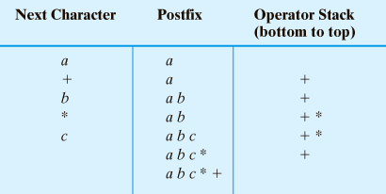
Transforming Infix to Postfix
Converting the infix expression a + b * c to postfix form

Slide 56
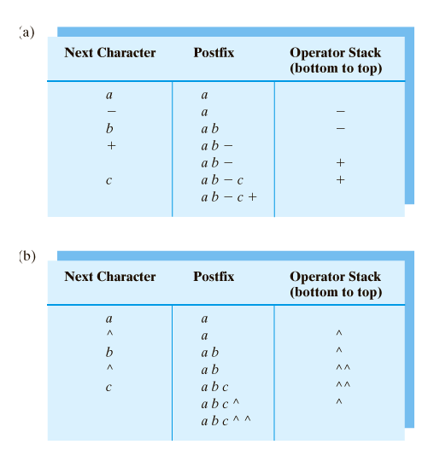
Converting infix expression to postfix form:
a – b + c

Slide 57
Infix to Postfix (RPN) Conversion
Algorithm
initialize stack and postfix output to empty;
while(not end of infix expression) {
get next infix item
if(item is operand) {
append item to postfix output
}
else if(item == ‘(‘ ) {
push item onto stack
}
else if(item == ‘)’ ) {
pop stack to x
while(x != ‘(‘ ) {
app.x to postfix output &
pop stack to x
}
}

Slide 58
else {
while(precedence(stack top) >= precedence(item)){
pop stack to x ;
app.x to postfix output
}
push item onto stack
}
}
while(stack not empty){
pop stack to x ;
append x to postfix output
}

Slide 59
Operator Precedence (for this algorithm):
4 : ‘(‘ - only popped if a matching ‘)’ is found
3 : All unary operators
2 : / *
1 : + -

Slide 60
Converting infix expression to postfix form:
a ^ b ^ c
An exception: if an operator is ^, push it onto the stack regardless of what is at the top of the stack

Slide 61
Infix-to-Postfix Algorithm
Symbol in Infix | Action
Operand | Append to end of output expression
Operator ^ | Push ^ onto stack
Operator +,-, *, or / | Pop operators from stack, append to output expression until stack empty or top has lower precedence than new operator. Then push new operator onto stack
Open parenthesis | Push ( onto stack, treat it as an operator with the lowest precedence
Close parenthesis | Pop operators from stack, append to output expression until we pop an open parenthesis. Discard both parentheses.

Slide 62
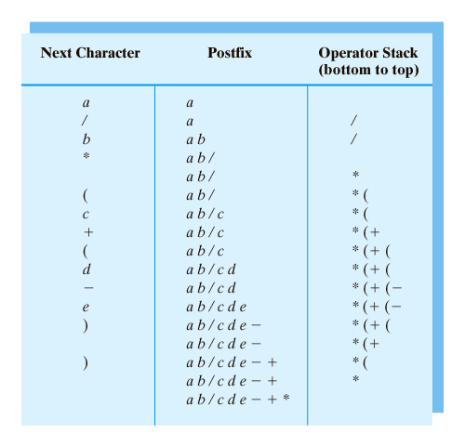
Steps to convert the infix expression a / b * ( c + ( d – e ) ) to postfix form.

Slide 63
(a + b)/(c - d)
a / (b - c) * d
a-(b / (c-d) * e + f) ^g
(a – b * c) / (d * e ^ f * g + h)

Slide 64
Answer
ab+cd-/
abc-/d*
abcd-/e*f + g^-
abc* -def^*g*h+/

Slide 65
Example:
Convert to postfix expression:
4 + 3*(6*3-12)
A + B * C + D
(A + B) * (C + D)
A+(B*C+D)/E
10 + 3 * 5 / (16 - 4)

Slide 66
Postfix Evaluation
Consider the postfix expression :
6 5 2 3 + 8 * + 3 + *

Slide 67
Evaluating Postfix Expression
Save operands until we find the operators that apply to them.
When see operator, is second operand is the most recently save value. The value saved before it – is the operator’s first operand.
Push the result into the stack. If we are at the end of expression, the value remains in the stack is the value of the expression.

Slide 68
Algorithm
initialise stack to empty;
while (not end of postfix expression) {
get next postfix item;
if(item is value)
push it onto the stack;
else if(item is binary operator) {
pop the stack to x;
pop the stack to y;
perform y operator x;
push the results onto the stack;
}
else if (item is unary operator) {
pop the stack to x;
perform operator(x);
push the results onto the stack
}
}
The single value on the stack is the desired result.

Slide 69
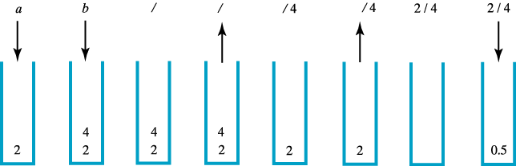
The stack during the evaluation of the postfix expression a b / when a is 2 and b is 4
Evaluating Postfix Expression

Slide 70
Binary operators: +, -, *, /, etc.,
Unary operators: unary minus, square root, sin, cos, exp, etc.,
Example:
Evaluate:
a) 6 5 2 3 + 8 * + 3 + *
b) 4 5 + 7 2 - *
c) 4 2 3 5 1 - + * +

Slide 71
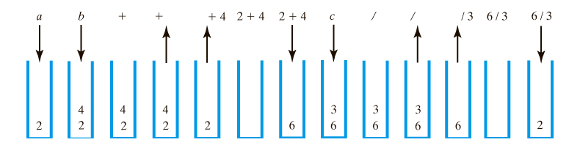
The stack during the evaluation of the postfix expression
a b + c / when a is 2, b is 4 and c is 3

Slide 72
Exercise:
Evaluate the following postfix expression. Assume that a=2, b=3, c=4, d=5, and e=6
ae+bd-/
abc*d*-
abc-/d*
ebca^*+d-

Slide 73
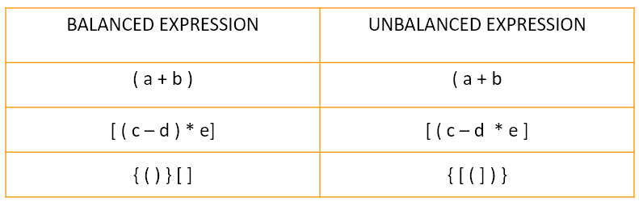
Application of stack:
Balanced parentheses using Stack
Here are some of the balanced and unbalanced expressions:

Slide 74
Steps to find whether a given expression is balanced or unbalanced
Input the expression and put it in a character stack.
Scan the characters from the expression one by one.
If the scanned character is a starting bracket ( ‘ ( ‘ or ‘ { ‘ or ‘ [ ‘), then push it to the stack.
If the scanned character is a closing bracket ( ‘ ) ’ or ‘ } ’ or ‘ ] ’ ), then pop from the stack and if the popped character is the equivalent starting bracket, then proceed. Else, the expression is unbalanced.
After scanning all the characters from the expression, if there is any parenthesis found in the stack or if the stack is not empty, then the expression is unbalanced.

Slide 75
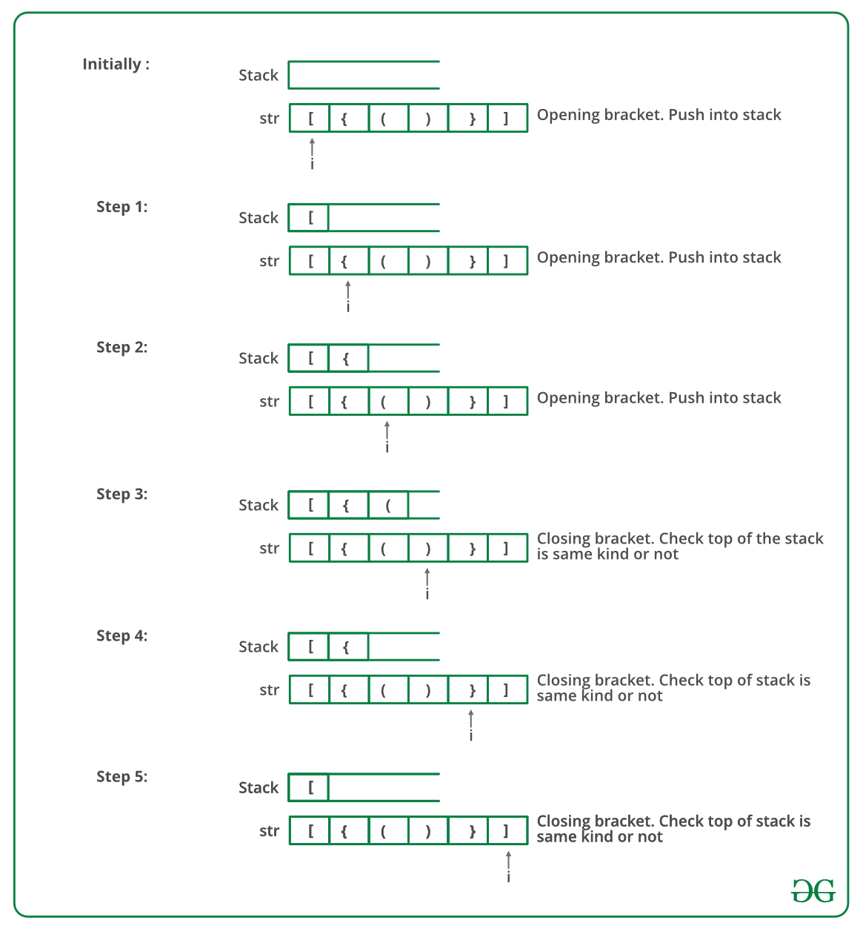

Slide 76
Stack in function calls
Program Stack: Program Stack is the stack which holds all the function calls, with bottom elements as the main function.
Stack Frame: Stack Frame is actually a buffer memory that is an element of program stack and has data of the called function ie
Return Address
Input Parameter
Local Variables
whenever a function is called a new stack frame is created with all the function’s data and this stack frame is pushed in the program stack

Slide 77
Series of operations when we call a function:
Stack Frame is pushed into stack.
Sub-routine instructions are executed.
Stack Frame is popped from the stack.
Now Program Counter is holding the return address.

Slide 78
Queue

Slide 79
Queue
Is an ordered collection of items from which items may be deleted at one end (called front of the queue) and into which items may be inserted at the other end (called the rear of the queue)
That is, it is a data structure that has access to its data at the front and rear

Slide 80
Queue
It is a First-In-First-Out (FIFO) data structure
That is, the first element inserted into a queue is the first element to be removed
The order in which elements enter a queue is the order in which they leave
This is in contrast with the queue

Slide 81
Queue
Examples of a queue in the real world
people waiting in line at the bank form a queue where the first person in line is the first person to be waited on
A line at the bus stop
Automobiles waiting to pass through an intersection (form a queue) in which the first car in line is the first car through
A group of cars waiting at a tool booth

Slide 82
Queue
Has three primitive operations applied to it
enqueue(q,x) also called insert(q,x)
Inserts item (data) x at the rear of the queue q
X=dequeue(q) also called remove(q)
Deletes the front element (data) from the queue q and sets X to its content
empty(q)
Returns false or true depending on whether or not the queue contains any elements

Slide 83
Queue
Example
Operation Content of queue
Enqueue(q, B)
Enqueue(q, C)
Enqueue(q)
Enqueue(q, G)
Enqueue(q, F)
Enqueue(q)
Enqueue(q, A)
Enqueue(q)

Slide 84
Queue
Two ways to represent (or implement) a queue
As an array
Simple array representation of queue
Circular array representation of queue
As a linked list

Slide 85
Simple array representation of queue
Array is used to hold the elements
We need two integer variables, FRONT and REAR, to hold the positions with in the array of the first and last elements of the queue
FRONT tells (or holds) the index of the front element
REAR tells (or holds) the index of the rear element
We also need the following integer variables
QUEUESIZE
tells (or holds) the total number of data in the queue
MAX_SIZE
tells (or stores) the capacity of the array (i.e. queue)

Slide 86
Simple array representation of queue
Initially FRONT and REAR must be initialized to -1
int FRONT = -1, REAR = -1;
Initially QUEUESIZE must be initialized to 0
int QUEUESIZE = 0
Remark
Using an array to hold a queue introduces the possibility of overflow if the queue should grow larger than the size of the array

Slide 87
Simple array representation of queue
Declaring a queue q of integers
#define MAXQUEUE 100
Struct queue{
int items[MAXQUEUE];
int front, rear;
}q;

Slide 88
Simple array representation of queue
Algorithm to enqueue data to the queue
Check if there is space in the queue
To do this ask this question
Is REAR < MAX_SIZE - 1 ?
If (REAR < MAX_SIZE - 1 ) is true
Increment REAR by 1
Store the data in queue[REAR]
Increment QUEUESIZE by 1
If (FRONT = = -1)
Increment FRONT by 1
If (REAR < MAX_SIZE - 1) is false
Display the message “Queue Overflow”

Slide 89
Simple array representation of queue
Algorithm to dequeue data from the queue
Check if there is data in the queue
To do this ask this question
Is QUEUESIZE > 0 ?
If (QUEUESIZE > 0) is true
Copy the data in queue[FRONT]
Increment FRONT by 1
Decrement QUEUESIZE by 1
If (QUEUESIZE > 0) is false
Display the message “Queue Underflow”

Slide 90
C++ implementation of enqueue and equeue
const int MAX_SIZE=100;
int FRONT =-1, REAR =-1;
int QUEUESIZE = 0;

Slide 91
C++ implementation of enqueue and equeue
void enqueue(char queue[], char x)
{
if(REAR < MAX_SIZE - 1)
{
REAR++;
queue[REAR] = x;
QUEUESIZE++;
if(FRONT = = -1)
FRONT++;
}
else
cout<<"Queue Overflow";
}

Slide 92
C++ implementation of enqueue and equeue
int dequeue(char queue[])
{
char x;
if(QUEUESIZE>0)
{
x=queue[FRONT];
FRONT++;
QUEUESIZE--;
}
else
cout<<"Queue Underflow";
return (x);
}

Slide 93
Array representation of queue
Example 1
Consider a queue with QUEUESIZE = 4 and write a C++ program that performs the operations shown in the table given in the next page
Answer
See queue3.cpp

Slide 94
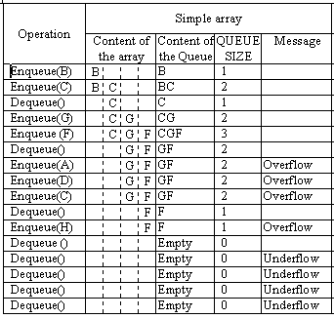
Simple array representation of queue

Slide 95
Limitation of simple array representation of queue
The array representation outlined earlier has a limitation
The variable rear is incremented but never decremented
Hence, it will quickly reach the end of the array
At that point, we will not be able to add any more elements to the queue, yet there is likely to be room in the array
In fact, it is possible to reach the absurd situation where the queue is empty, yet no new element can be inserted
In normal application, the variable front would also be incremented from time to time (when entries are removed from the queue)
This will free up the array application with index values less than front
Different solutions to overcome this problem

Slide 96
Solution 1
For using the freed array locations
Maintain all the queue entries so that front is always equal to 0 (the first index of the array)
When queue[0] is removed, we move all the entries in the array down one locations, so that the value of queue[1] is moved to queue[0], and then all other entries are also moved
How is the above method implemented (see next slide)

Slide 97
Solution 1
Modify the dequeue operation so that when an item is deleted, the entire queue is shifted to the beginning of the array
Ignoring the possibility of overflow, the operation x=dequeue(queue) would be modified as follows
x=queue(FRONT);
for(int i = 0; i < REAR; i++)
{
queue[i] = queue[i+1];
}
REAR--;

Slide 98
Solution 1 …
The queue need no longer contain a front field
This is because, the element at position 0 of the array is always at the front of the queue
The empty queue is represented by the queue in which rear is -1

Slide 99
Solution 1 …
Is this method efficient?
The method will work
But, it is not efficient, in fact too inefficient
Each deletion involves moving every remaining element of the queue
Every time we remove an entry from the queue, we must move every entry in the queue
If a queue contains 500 or 100 elements, this is high a price to pay
Further, the operation of removing an element from a queue logically involves manipulation of only one element
The implementation of that operation should reflect this and should not involve a host of extraneous operations

Slide 100
Solution 1 …
Exercise
Include exercise 4.1.3

Slide 101
Solution 2
Is a better approach
We do not need to move all the array elements
When the rear index reaches the end of the array, we can simply start using the variable locations at the front
One way to think of this arrangement is to think of the array as being bent into a circle so that the first component of the array is immediately after the last component of the array
That is, the successor of the last array index is the first array index

Slide 102
Solution 2…
In this arrangement (circular queue), the free index positions are always to the “right after” queue[REAR]
Example
Consider a queue of characters with a capacity of 4
Perform the operations given in the table in the next slide considering the queue is represented as circular array rather than simple array
See also D

Slide 103
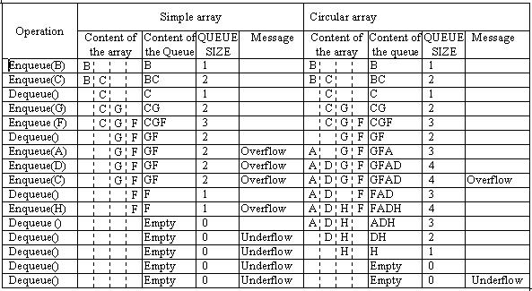
Solution 2 …

Slide 104
Solution 2 …
With this view, the queue’s entries start at queue[FRONT] and continue forward
If you reach the end of the array, then come back at queue[0], and keep going until you find the REAR
It may help to actually view the array as bent circle, with the final array element attached back to the front as shown below
104
Incude diagram and the statement just above it on kinfe
See also mu not
An array used in this way is called a circular array (if we have free slot we can use it)

Slide 105
Solution 2 …
The circular array implementation of a queue with capacity QUEUESIZ can be simulated as follows:
An array used in this way is called a circular array (if we have free slot we can use it)
In any case, queue[rear] is the last entry in the queue
13
12
11
10
9
MAX_SIZE - 1
8
0
7
1
6
2
3
4
5

Slide 106
Circular array implementation of queue
Consider the structure queue[QUEUESIZE]
We need to have three integer variables, FRONT, REAR and QUEUESIZE and MAX_SIZE
REAR tells (stores) the index of the front element
FRONT tells (stores) the index of the rear element
QUEUESIZE tells (stores) the total number of data in the queue
MAX_SIZE tells (stores) the capacity of the queue
Initially FRONT and REAR must be initialized to -1
int FRONT = -1, REAR = -1;
Initially QUEUESIZE must be initialized to 0
int QUEUESIZE = 0;

Slide 107
Circular array implementation of queue
Algorithm to enqueue data to the queue
Check if there is space in the queue
To do this ask this question
Is QUEUESIZE < MAX_SIZE ?
If(QUEUESIZE < MAX_SIZE ) is true
Increment REAR by 1
If(REAR = = MAX_SIZE)
REAR = 0
Store the data in queue[REAR]
Increment QUEUESIZE by 1
If(FRONT = = -1)
Increment FRONT by 1
If(QUEUESIZE < MAX_SIZE ) is false
display the message “Queue Overflow”

Slide 108
Circular array implementation of queue
Algorithm to dequeue data from the queue
Check if there is data in the queue
To do this ask this question
Is QUEUESIZE > 0 ?
If(QUEUESIZE > 0 ) is true
Copy the data in queue[FRONT]
Increment FRONT by 1
If(FRONT == QUEUESIZE)
Set FRONT = 0
Decrement QUEUESIZE by 1
If(QUEUESIZE > 0 ) is false
Display the message “Queue Overflow”

Slide 109
C++ implementation of enqueue and equeue (circular array of queue)
const int MAX_SIZE=100;
int FRONT =-1, REAR =-1;
int QUEUESIZE = 0;

Slide 110
C++ implementation of enqueue and equeue (Circular array of queue)
void enqueue(int x)
{
if(QUEUESIZE<MAX_SIZE)
{
REAR++;
if(REAR = = MAX_SIZE)
REAR=0;
Num[REAR]=x;
QUEUESIZE++;
if(FRONT = = -1)
FRONT++;
}
else
cout<<"Queue Overflow";
}

Slide 111
C++ implementation of enqueue and equeue (Circular array of queue)
int dequeue()
{
int x;
if(QUEUESIZE>0)
{
x=Num[FRONT];
FRONT++;
if(FRONT = = MAX_SIZE)
FRONT = 0;
QUEUESIZE--;
}
else
cout<<"Queue Underflow";
return(x);
}

Slide 112
C++ implementation of enqueue and equeue (Circular array of queue)
Example 3
Assume a queue is implemented as circular array MAX_SIZE = 4 and write a C++ program that performs the operations shown in the table given in the next page
Answer
See queue5.cpp

Slide 113
C++ implementation of enqueue and equeue (Circular array of queue)

Slide 114
C++ implementation of enqueue and equeue (Circular array of queue)
Example 4
This is another example on a circular array implementation queue
See queue6.cpp

Slide 115
Linked list implementation of enqueue and dequeue operations
Enqueue- is inserting a node at the end of a linked list
Dequeue- is deleting the first node in the list
Define the structure to hold references to queue nodes for the linked queue implementation
struct queue {
char item;
queue next
};
queue *frontPtr=NULL; //references to the front of the queue
queue *rearPtr=NULL; //references to the rear of the queue

Slide 116
Linked list implementation of enqueue operation
/* Adds item to the rear of this queue */
void enqueue(char x)
{
queue * temp = new queue;
if(temp == NULL)
cout<<“\nQueue is FULL”;
temp->item = x;
temp -> next = NULL;
to be checked
if(rearPtr == NULL)
frontPtr=temp;
else
rearPtr -> next = temp;
rearPtr = temp;
}

Slide 117
Linked list implementation of dequeue operation
/* Removes front element form this queue and return it */
void dequeue()
{
char data;
data = frontPtr -> item;
frontPtr = frontPtr -> next;
if(frontPtr == NULL)
rearPtrr = NULL;
return data;
}

Slide 118
Linked list implementation of enqueue and dequeue operations
Example
queue7.cpp
Queue8.cpp

Slide 119
Deque (pronounced as Deck)
Is a Double Ended Queue
A stack allows insertion and deletion of elements at only one end
A queue allows insertion at one end and deletion at the other end
A deque allows insertion and deletion at both ends
insertion and deletion can occur at either end
Front
Rear
DequeueFront
EnqueueFront
DequeueRear
EnqueueRear

Slide 120
Deque (pronounced as Deck)
Has the following basic operations
EnqueueFront – inserts data at the front of the list
DequeueFront – deletes data at the front of the list
EnqueueRear – inserts data at the end of the list
DequeueRear – deletes data at the end of the list
Implementation is similar to that of queue
Is best implemented using doubly linked list

Slide 121
Deque (pronounced as Deck)
Example
Queue9.cpp
Exercise
How can a queue be represented as a C++ array?
Write four O(1)-time procedures EnqueueFront, DequeueFront, EnqueueRear and DequeueRear to insert elements into and delete elements from both ends of a deque constructed from an array. Make sure that the functions work properly for the empty deque and that they detect overflow and underflow

Slide 122
Priority Queue
Using a queue ensures that customers are served in the exact order in which they arrive
However, we often want to assign priorities to customers and serve the higher priority customers before those of lower priority
In fact, in many situations, simple queues are inadequate since first-in-first-out scheduling has to be overruled using some priority criteria
Examples
A hospital emergency room will handle most severely injured patients first, even if they are not “first in line”
In situations like this, a modified queue, or priority queue, is needed

Slide 123
Priority Queue
Is a data structure that stores entries along with a priority for each entry
Is a queue where each element has an associated key which indicates priority of the elements
This key is provided at the time of insertion
Entries are removed in order of priorities
The highest priority entry is removed first
If there are several entries with equal high priorities, then the one that was placed in the priority queue first is the one removed first

Slide 124
Priority Queue
That is, in priority queues, elements are dequeued according to
Their priority and
Their current queue position
Elements arrive randomly to the priority queue
Thus, there is no guarantee that the front elements will be the most likely to be dequeued and the elements put at the end will be the last candidates for dequeueing

Slide 125
Priority Queue
A wide spectrum of possible criteria can be used to prioritize elements in different cases
Frquency of use
Birth date
Salary
Postion
Status
gender

Slide 126
Priority queue enqueue and dequeue operations
Dequeue operation deletes data having highest priority in the list
One of the previously used dequeue or enqueue operations has to be modified
Example:
Consider the following queue of persons where females have higher priority than males (gender is the key to give priority).
Abebe
Alemu
Aster
Belay
Kedir
Meron
Yonas
Male
Male
Female
Male
Male
Female
Male

Slide 127
Priority queue enqueue and dequeue operations
Dequeue() deletes Aster
Dequeue() deletes Meron
Now the queue has data having equal priority and dequeue operation deletes the front element like in the case of ordinary queues.
Abebe
Alemu
Belay
Kedir
Meron
Yonas
Male
Male
Male
Male
Female
Male
Abebe
Alemu
Belay
Kedir
Yonas
Male
Male
Male
Male
Male

Slide 128
Priority queue enqueue and dequeue operations
Dequeue() deletes Abebe
Dequeue() deletes Alemu
Thus, in the above example the implementation of the dequeue operation need to be modified.
Alemu
Belay
Kedir
Yonas
Male
Male
Male
Male
Belay
Kedir
Yonas
Male
Male
Male

Slide 129
Types of Priority queues
There are two types of priority queues, ascending priority queue and descending priority queue

Slide 130
Ascending Priority Queue
Is a collection of items into which items can be inserted arbitrarily and from which only the smallest item can be removed
The operation enqueue(pq,x) insrtes element x into the pq and
The operation dequeue(pq) removes the minimum element from pq and returns its value the queue

Slide 131
Descending Priority Queue
Is a collection of items into which items can be inserted arbitrarily and from which only the largest item can be removed
The operation enqueue(pq,x) inserts element x into the pq and is logically identical with the enqueue(pq,x) operation for an ascending priority queue
The operation dequeue(pq) removes the maximum element from pq and returns its value

Slide 132
Priority queue
Examples
Queue10.cpp (array implementation)
Queue11.cpp (ascending priority)
Linked list implementation
Queue12.cpp (descending priority)
Linked list implementation
Queue13.cpp
Linked list implementation
Queue14.cpp
Linked list implementation
Queue15.cpp
Linked list implementation

Slide 133
Reading assignment
Demerging queues
Merging queues
Application of queues
Page 61

